Slide 1
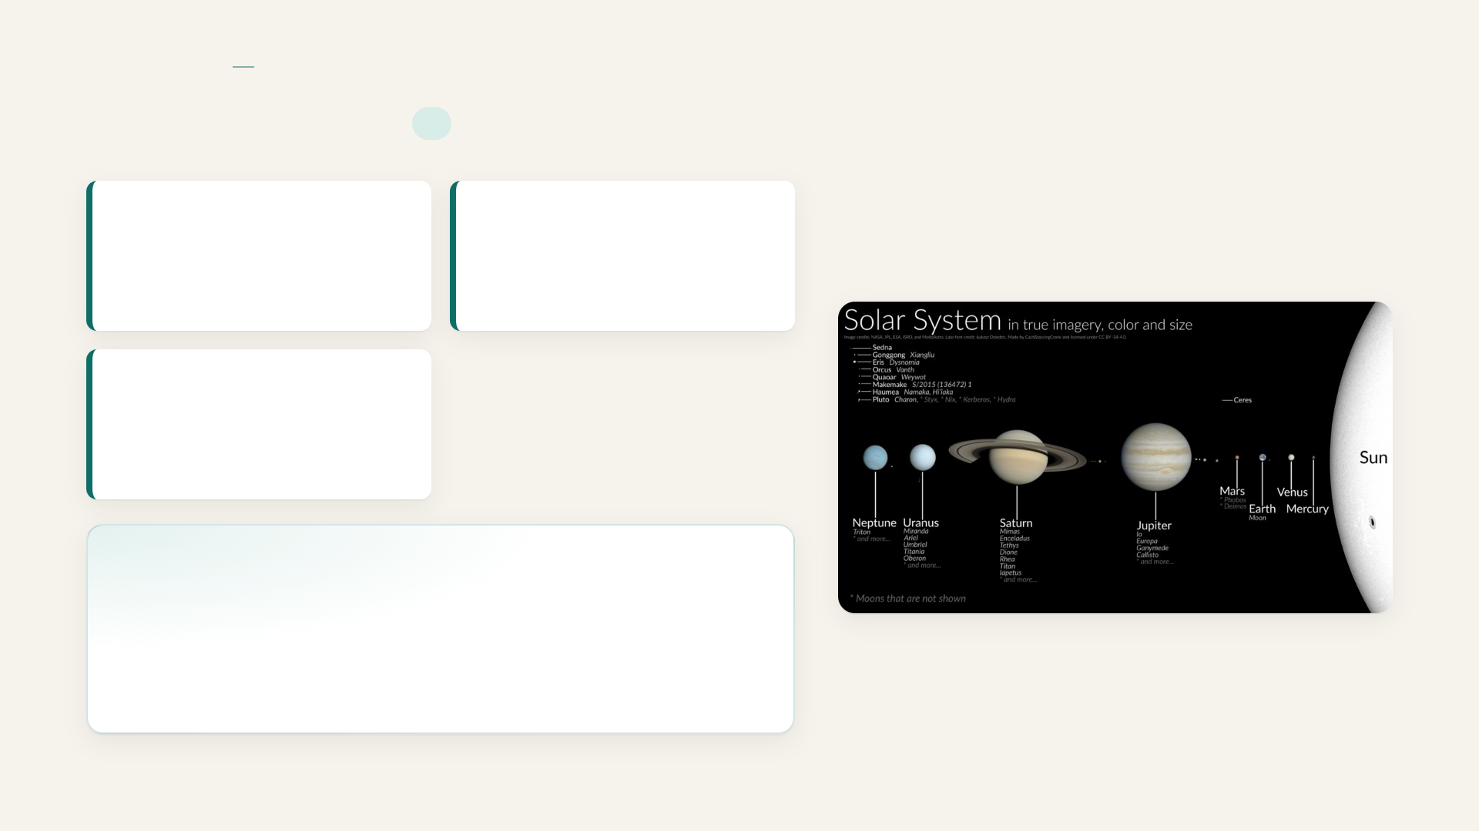
SOLAR SYSTEM
OVERVIEW
Solar system
I
Gravitationally bound
Formation time
Solar system
4.6 billion years ago
Location
Orion Arm of the Milky Way Galaxy
Solar system
The system consisting of the Sun and the objects that orbit it, including eight planets, dwarf planets, moons, asteroids and comets.
Notes:
Solar system

Slide 2

ORDER OF PLANETS FROM THE SUN
Mercury
SOLAR SYSTEM
OVERVIEW
1
Solar system
II
2
Venus: dense toxic sulfuric acid atmosphere; greenhouse effect makes it hottest planet
3
Earth, the third planet from the Sun and the only known astronomical body that harbors life
4
Mars, the red planet with iron‑oxide surface, polar ice caps, and past evidence of liquid water
5
Jupiter – the largest planet, a massive gas giant with a great red spot and dozens of moons
6
Saturn
7
Uranus
8
Neptune
Smallest planet
Closest to Sun
Rocky surface
Mercury
Mercury
Mercury
Notes:
Solar system

Slide 3

SOLAR SYSTEM
OVERVIEW
Solar system
III
Jupiter
the largest planet, a massive gas giant with a prominent great red spot and dozens of moons
Bright ring system
Low densities
Uranus
an ice giant that rotates nearly on its side, possessing a cold atmosphere and a faint ring system.
Notes:
Solar system

Slide 4

SOLAR SYSTEM
OVERVIEW
Solar system
IV
Neptune
the outermost recognized major planet and an ice giant with deep blue hues and ultra‑fast winds
Sun type
Sun mass proportion
Yellow dwarf star
99.8% of total solar system mass
Notes:
Solar system

Slide 5

SOLAR SYSTEM
INNER AND OUTER PLANETS
Inner vs Outer planets
PLANETS BY TYPE
Inner Rocky Planets
Outer Gas and Ice Giants
Mercury
Venus
Earth
Mars
Jupiter
Saturn
Uranus
Neptune
Notes:
Inner vs Outer planets

Slide 6
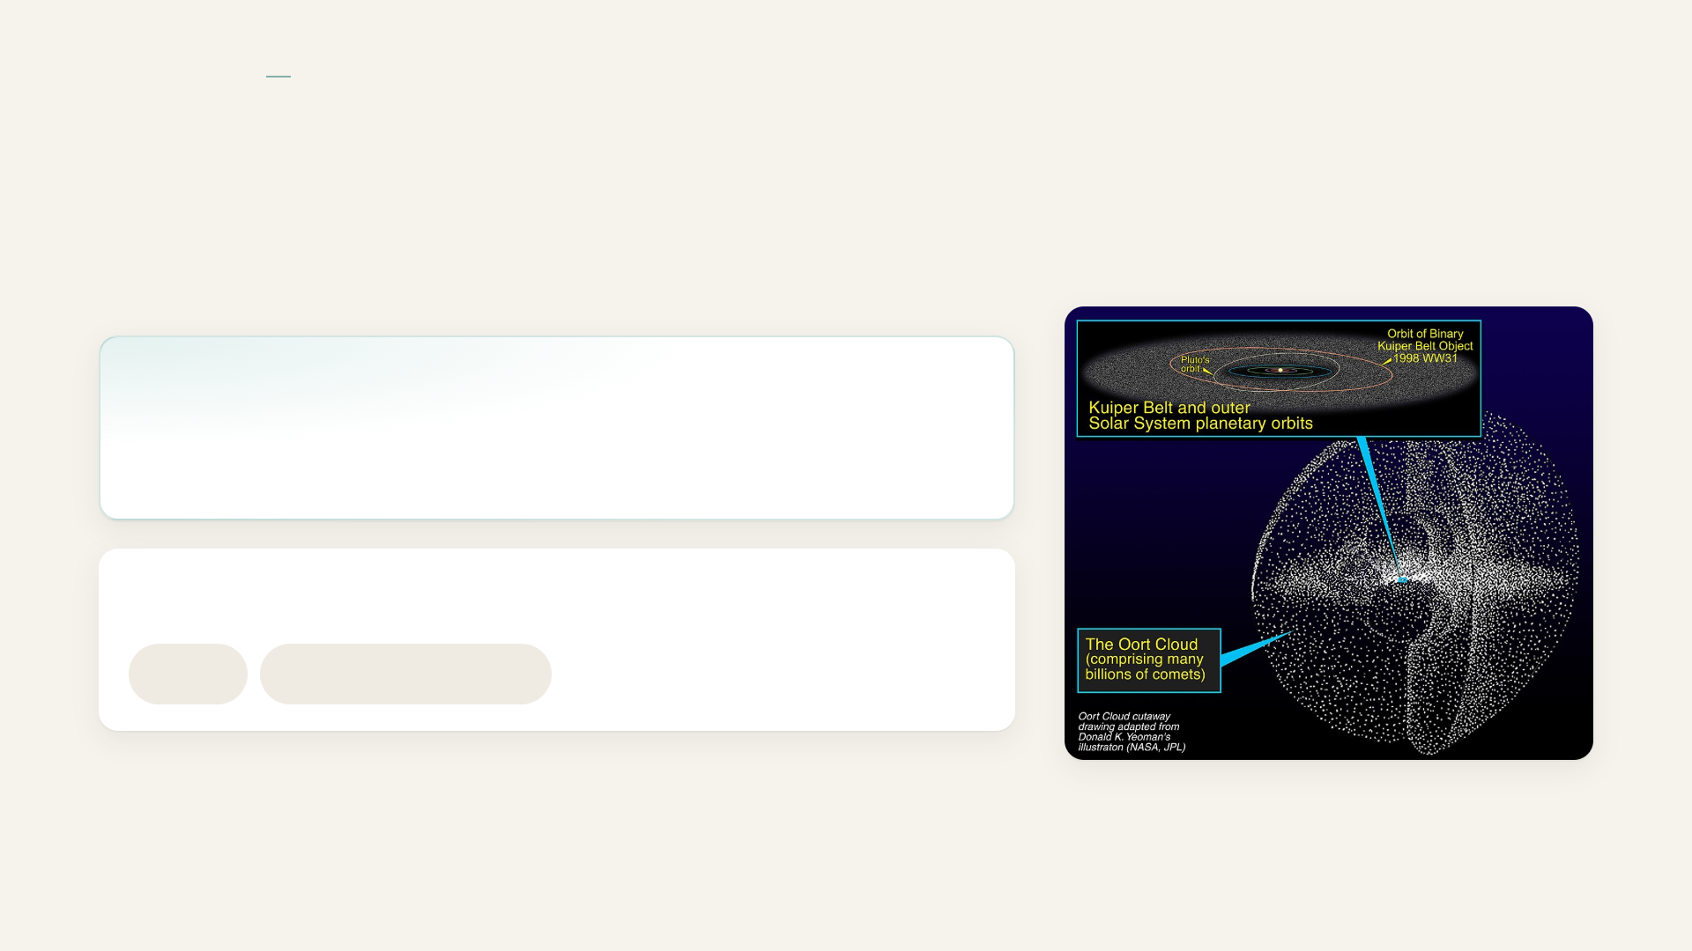
SOLAR SYSTEM
DWARF PLANETS AND KUIPER BELT
Dwarf Planets and Kuiper Belt
Dwarf planet
a body that orbits the Sun but is not a planet
Kuiper Belt
Pluto
Other icy bodies
Notes:
Dwarf Planets and Kuiper Belt

Slide 7
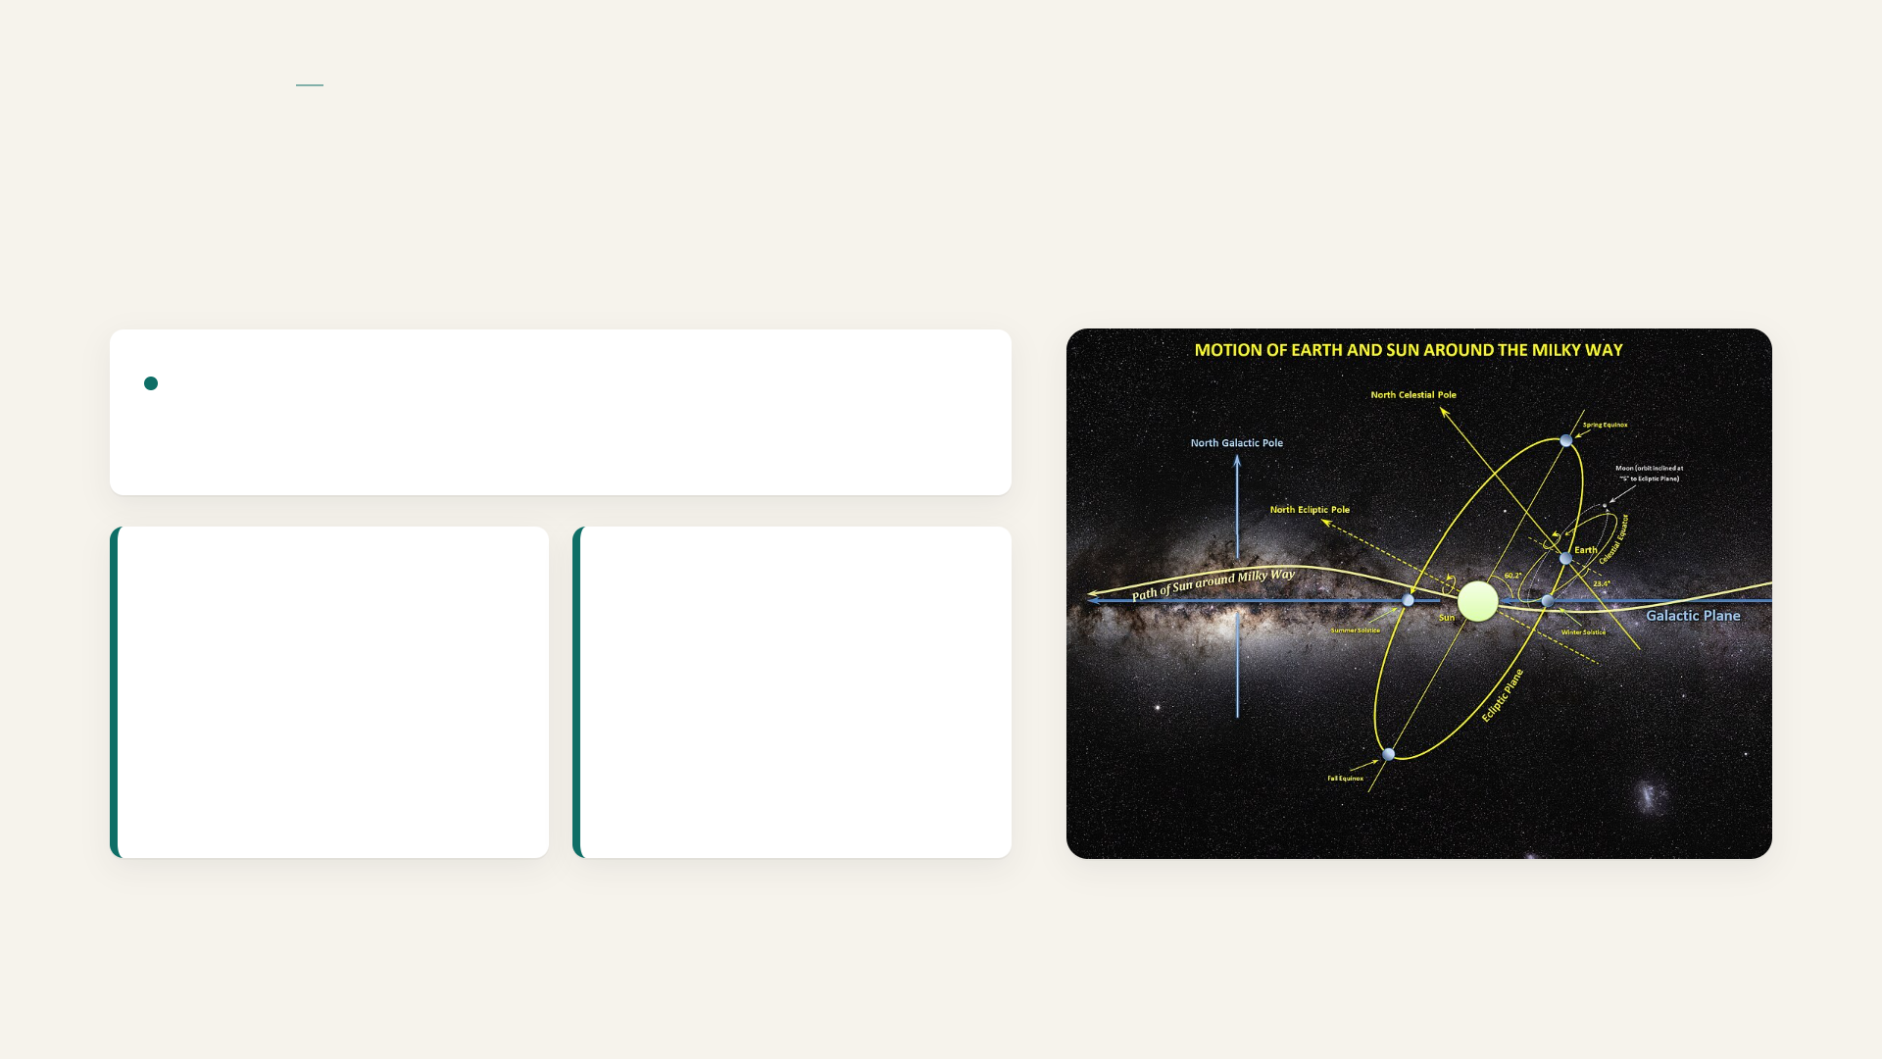
SOLAR SYSTEM
GALACTIC BODIES
Galactic Bodies
Solar system travels around Milky Way center
Solar system orbital speed
Full circuit time
≈200 million years
≈514,000 miles per hour (≈828 km/s)
Notes:
Galactic Bodies

